Slide 1



Diphtheria Briefing
Lisa Eastmead-Hoare
Lead IPC Manager
14th November 2022
With thanks to UKHSA and Lisa Hocking, Deputy Director of IP&C and Associate Chief Nurse @ RUH

Slide 2
What is Diphtheria
Highly contagious infection that affects the nose and throat and sometimes the skin.
Incubation period usually 2-5 days, with a range of 1-10 days.
C. diphtheriae and C. ulerans may present with either cutaneous and/or respiratory presentations and lead to severe infection and mortality.
Diphtheria is rare in the UK due to the vaccination program where children and babies have been routinely vaccinated since the 1940s but there is a small chance of contracting the infection if you travel to certain parts of the world.
Working Together to Improve Health and Wellbeing

Slide 3
Current Situation
34 confirmed diphtheria infection cases across asylum seeker settings in England this year.
12 confirmed cases of diphtheria (9 of which have been confirmed in the last 4 days) since 11th October 2022 at Manston Reception facility
3 confirmed cases identified since 4th October Kent Intake Unit (unaccompanied children)
Early reports identify this situation of increased toxigenic diphtheria cases in people seeking asylum is mirrored across several European Countries.
Working Together to Improve Health and Wellbeing

Slide 4
Management of Confirmed or Suspected Diphtheria
Suspected and confirmed cases should be assessed and treated promptly with a detailed risk assessment to identify close contacts.
Diphtheria is a notifiable disease and all suspected cases should be referred to local Health Protection Teams (HPT) - 0300 303 8162 swhpt@ukhsa.gov.uk
Swabs – nasopharyngeal, throat, wound or skin lesions (including screening for respiratory carriage in cutaneous cases) prior to commencing treatment.
Treatment - 14-day course of antibiotics and contacts will receive prophylactic antibiotics
Cases of suspected classical respiratory diphtheria should be urgently assessed by clinicians for Diphtheria Anti-toxin Therapy (DAT)
Vaccines are given to cases on recovery and contacts ASAP
Working Together to Improve Health and Wellbeing

Slide 5
Current Incident Response
National Incident Management team have recommended mass antibiotics and vaccination to the following groups:
Asylum seekers currently in the Manston and Kent intake units
Asylum seekers arriving in the Marston and Kent intake units for the next month dependent on clinical presentation assessment, microbiology, feasibility and acceptability.
Any asylum seekers that have left Marston or Kent intake units since 31/10/22 to be identified and treated ASAP.
Working Together to Improve Health and Wellbeing

Slide 6
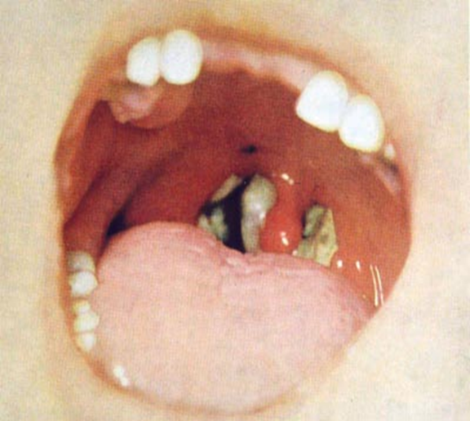
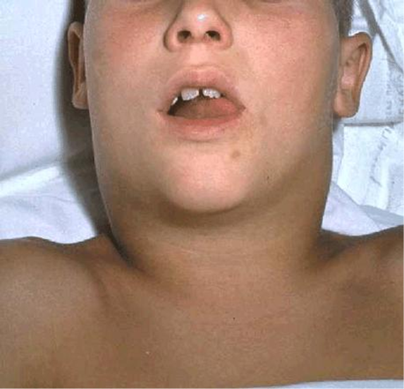
Clinical Presentation
Classical Respiratory Diphtheria:
Inflammatory pseudomembrane on tonsils, oropharynx and pharynx
“bull neck” appearance
Sore throat
Fever
Potentially death
Laryngeal Diphtheria:
Hoarseness
Stridor
Working Together to Improve Health and Wellbeing

Slide 7
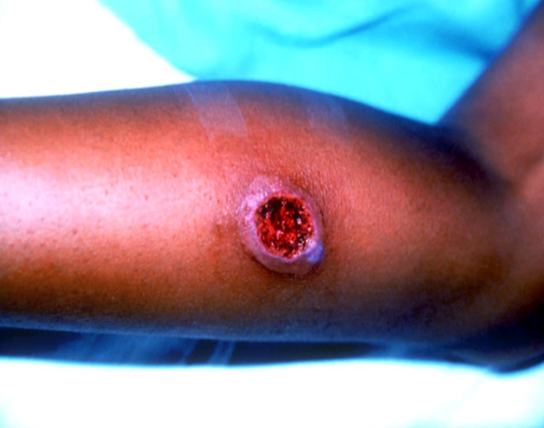
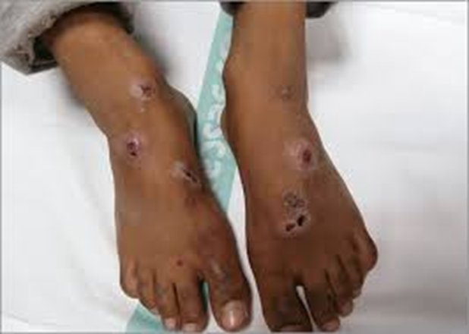
Clinical Presentation contd….
Nasal Diphtheria:
Mild or chronic nasal discharge – clear to bloody in appearance
Cutaneous Diphtheria:
Usually on exposed limbs
Lesions start as vesicles – from small, clearly demarcated, sometimes multiple
Lesions usually covered with an eschar, a hard slightly raised bluish-grey membrane
Note: ulcers may be difficult to distinguish from impetigo
Working Together to Improve Health and Wellbeing

Slide 8
Case Definition
Confirmed case of toxigenic infection:
Classic respiratory diphtheria and
Either laboratory confirmation of a toxigenic strain or
Epidemiological link to a laboratory-confirmed case with a toxigenic strain or
Laboratory confirmation of a toxigenic strain with other presentations of diphtheria including mild respiratory or cutaneous
Probable case of toxigenic infection:
Classic respiratory diphtheria and
No laboratory confirmation C. diphtheriae, C. ulcerans or C. pseudotuberculosis has yet been isolated from a relevant swab, or where a strain has been isolated BUT toxigenicity status has not yet been confirmed and
No epidemiological link to a laboratory-confirmed case with a toxigenic strain or
A severely unwell patient withC. diphtheriae, C. ulcerans or C. pseudotuberculosis has yet been isolated from a relevant swab, or where a strain has been isolated BUT toxigenicity status has not yet been confirmed e.g. laryngeal disease or
Other presentations of diphtheria with a confirmed epidemiological link to a laboratory confirmed case.
Diphtheria: public health control and management in England - GOV.UK (www.gov.uk)
Working Together to Improve Health and Wellbeing

Slide 9
Case definition continued:
Possible case of toxigenic infection:
Other presentations of diphtheria and
Isolation of C. diphtheriae, C. ulcerans or C. pseudotuberculosis in a pharyngeal, skin, or other appropriate swab, but toxigenicity status has not yet been confirmed.
Asymptomatic carrier of toxigenic strain:
No symptoms and
Laboratory confirmation of toxigenic strain form any anatomical site
Case of non-toxigenic toxin gene-bearing (NTTB) Corynebacteria infection:
Other presentations of diphtheria and
Isolation of NTTB corynebacterial (PCR toxin gene positive, Elek negative)strain in a pharyngeal, skin, or other appropriate swab.
Asymptomatic carrier of NTTB strain:
No symptoms and
Laboratory confirmation of NTTB corynebacterial (PCR toxin gene positive, Elek negative) strain form any anatomical site
Not confirmed or non-toxigenic case (discarded):
If other compatible organisms are isolated. Or if corynebacteria isolated but are confirmed to be a non-toxigenic strain, they would no longer fit the case definition of a probable or possible case.
Diphtheria: public health control and management in England - GOV.UK (www.gov.uk)
Working Together to Improve Health and Wellbeing

Slide 10
Infection Prevention and Control
Standard and Transmission based precautions:
Contact, droplet and airborne transmission
Contact – cutaneous from vesicles
Droplet – pharyngeal infection/colonisation
Airborne – AGPs
Gloves
Aprons – when contamination is anticipated
Fluid repellent surgical mask if risk of secretions onto respiratory mucosa
FFP3 or hood for AGPs
Eye protection if anticipated blood of bodily fluid during AGP
Follow guidance from the National Infection prevention and Control manual for England: NHS England » National infection prevention and control
Working Together to Improve Health and Wellbeing

Slide 11
General information
80% of individuals currently in or arriving into Manston within the previous month have extensive skin lesions and infections on arrival.
Balance between identifying and treating common conditions such as strep, staph, fungal infections, scabies etc and keeping wide differential diagnosis so issue like diphtheria are not missed.
Health needs tend to be high at the point of arrival to this country due to background infection exposure, prolonged travel, challenging living conditions and long periods without access to health care.
Think “Person First, Context Second”
Working Together to Improve Health and Wellbeing

