Slide 1

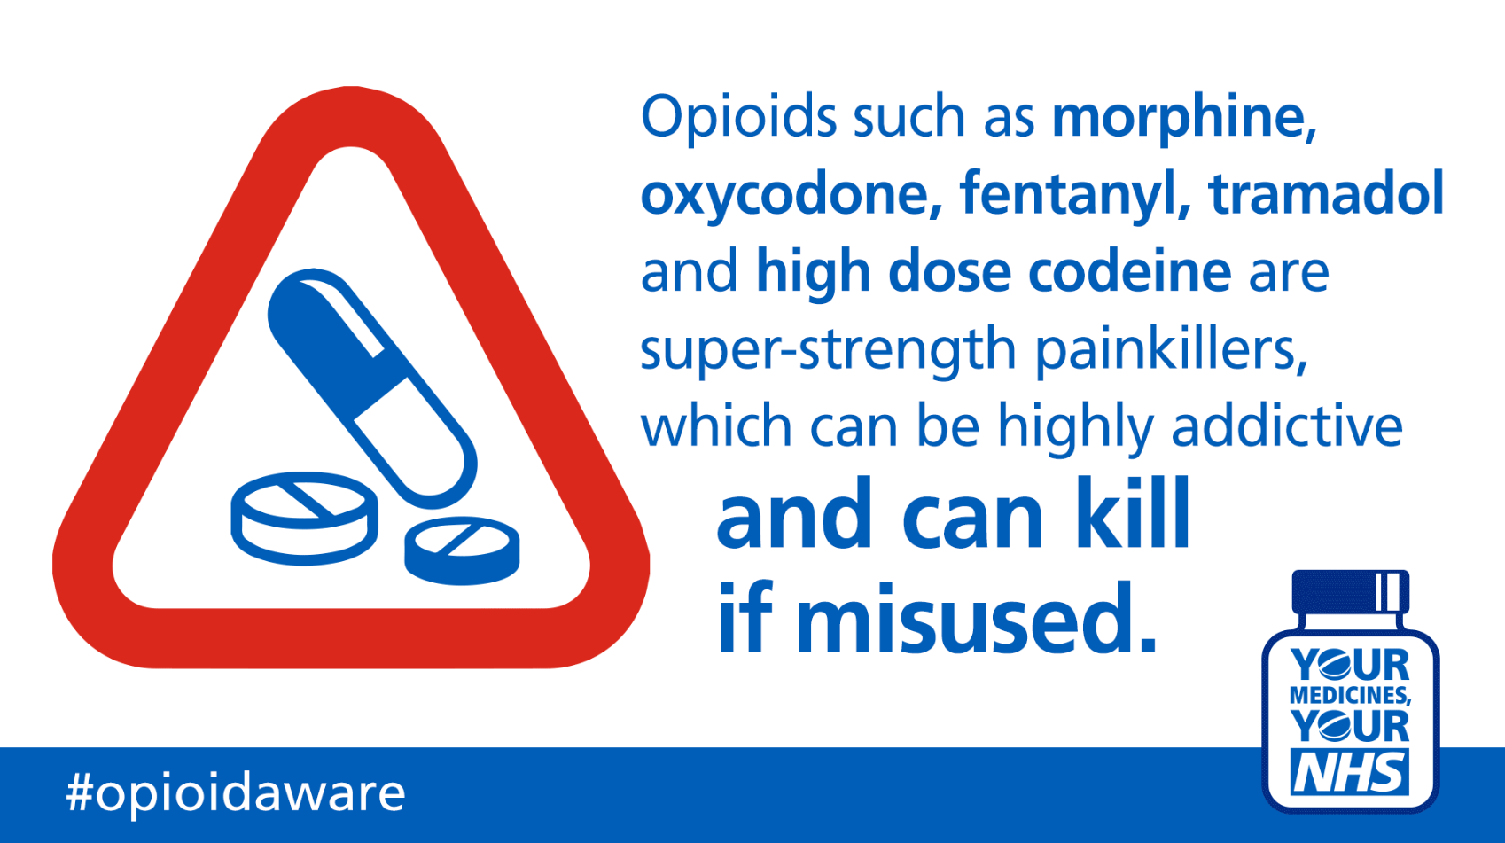
With acknowledgment to NHS Yarmouth and Waveney CCG

Slide 2
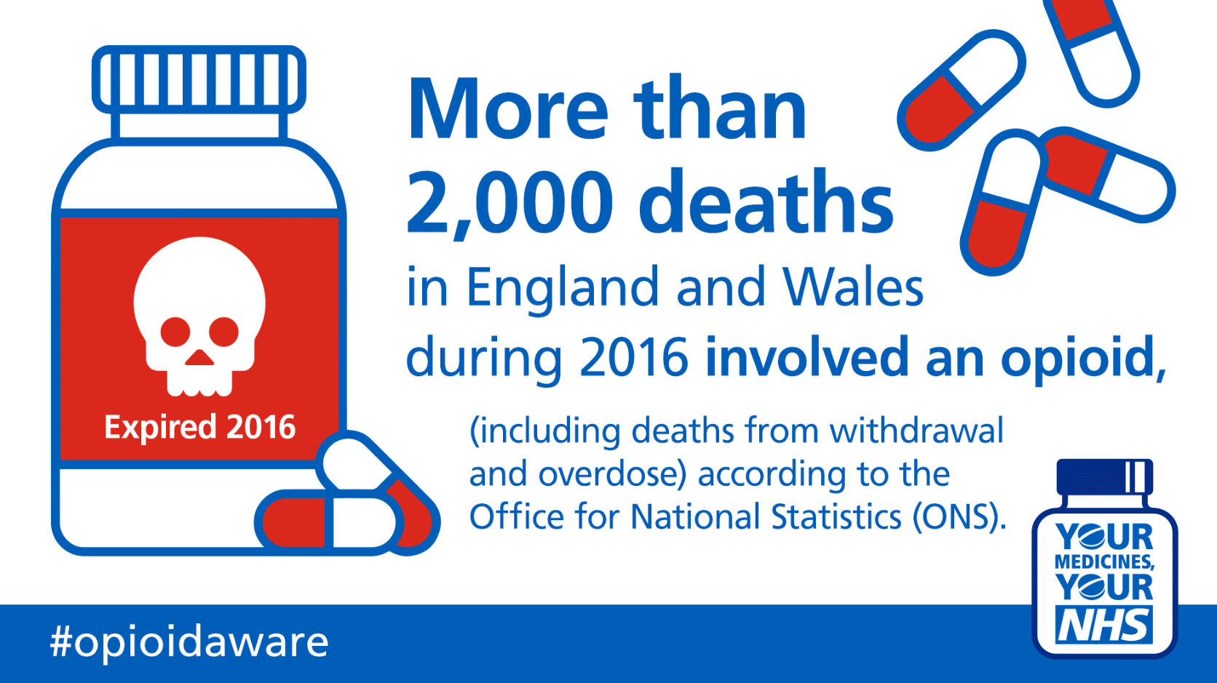
With acknowledgment to NHS Yarmouth and Waveney CCG

Slide 3
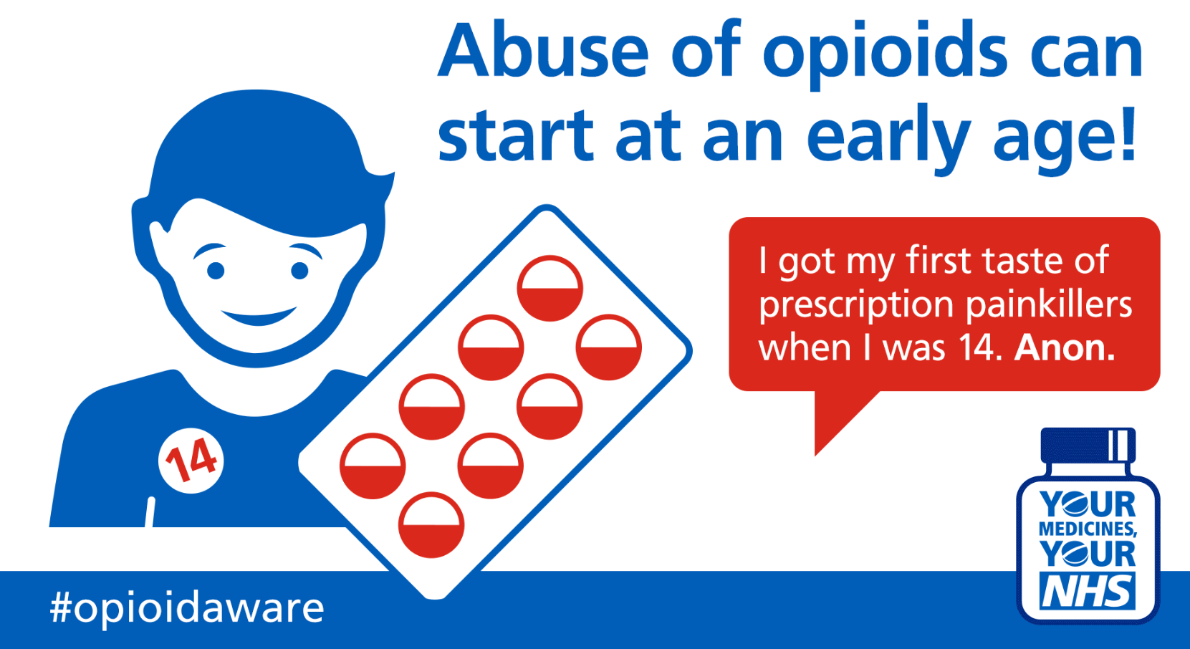
With acknowledgment to NHS Yarmouth and Waveney CCG

Slide 4
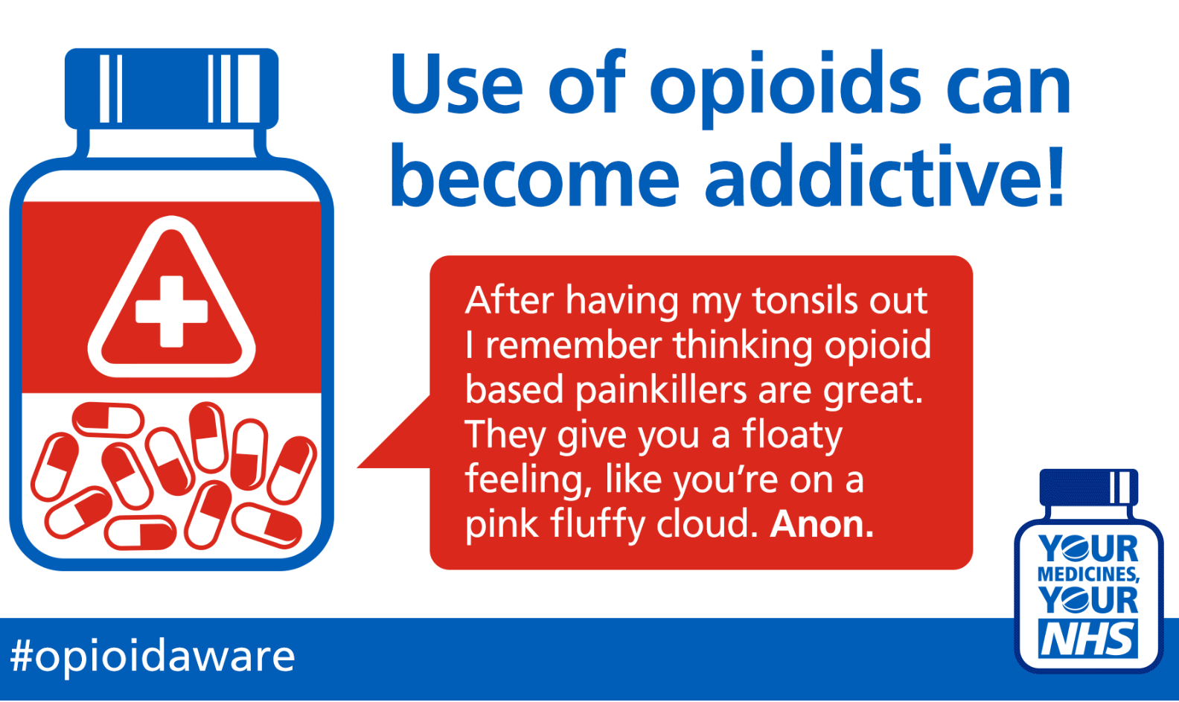
With acknowledgment to NHS Yarmouth and Waveney CCG

Slide 5

With acknowledgment to NHS Yarmouth and Waveney CCG

Slide 6

With acknowledgment to NHS Yarmouth and Waveney CCG

Slide 7
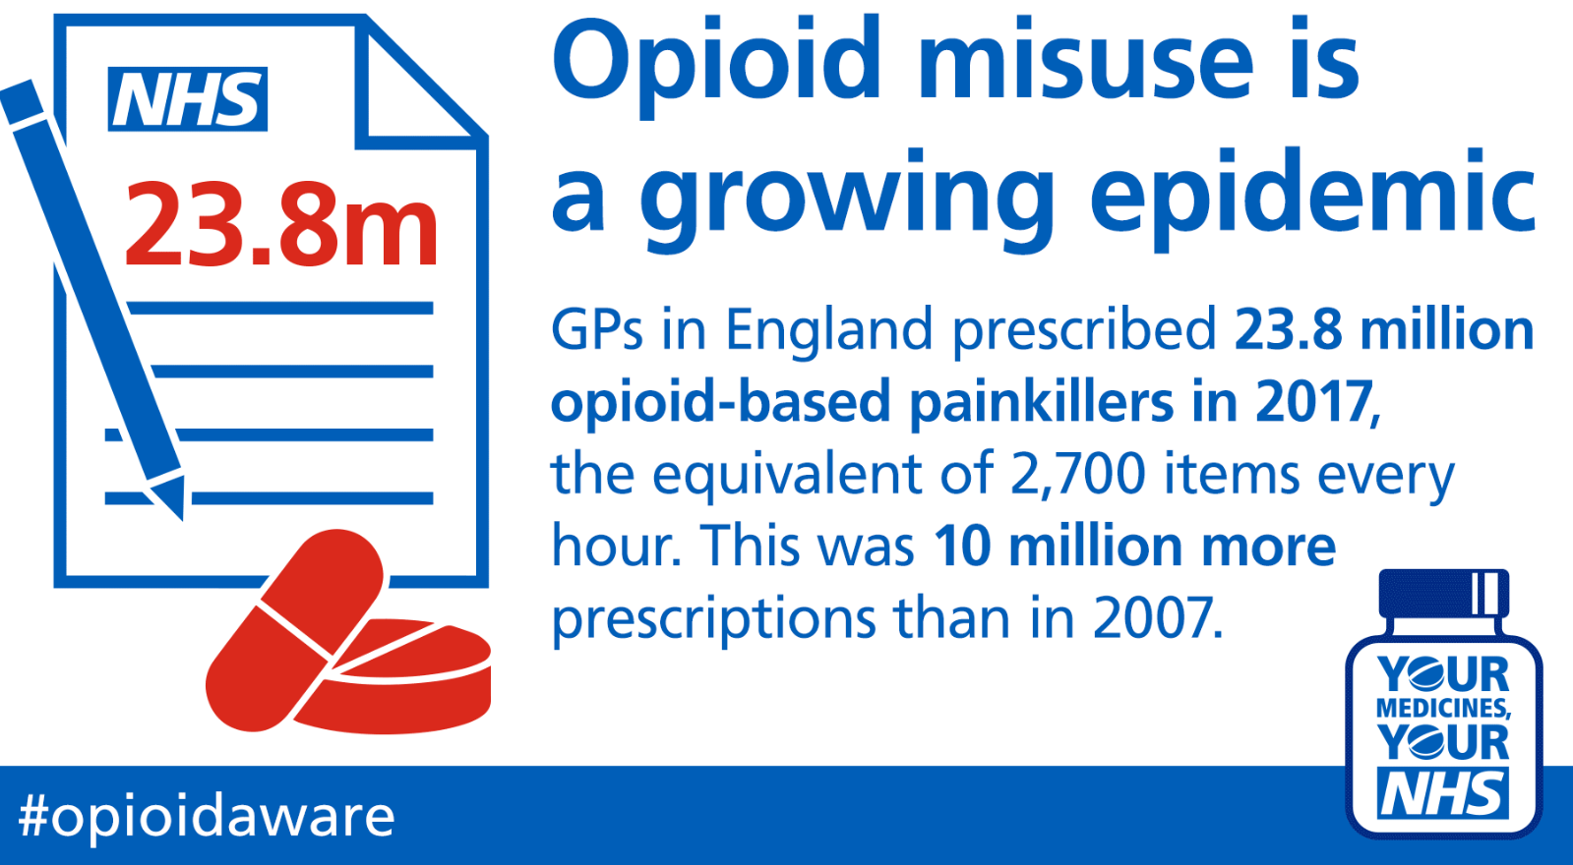
With acknowledgment to NHS Yarmouth and Waveney CCG

