Slide 1
Norovirus
In a social care setting
August 2024

Slide 2
Definition
Epidemiology
Etiology
Pathophysiology and pathogenesis
Immune Response
Transmission and communicability
Diagnosis
Treatment and management
Prevention

Slide 3
Definition
‘Norovirus are a group of non-enveloped, single-stranded RNA viruses that primarily cause acute gastroenteritis, (inflammation of the stomach and/or intestines)’
(CDC, 2021)

Slide 4
Epidemiology
Norovirus is a viral illness that is the most common cause of acute gastroenteritis globally
Symptoms of norovirus include acute onset diarrhoea and vomiting
An estimated 685 million cases of norovirus are seen annually, including 200 million cases amongst children under 5
Norovirus causes an estimated 200,000 deaths per year, including 50,000 child deaths, primarily impacting low-income countries
It has been estimated to cost £60 billion globally in healthcare and economic losses WHO, (2022)
Once an individual has had norovirus, it does not offer protection against further infections due to it changing over time and geography, there are a minimum of five different norovirus genogroups, (Weston, D 2013)
Norovirus was previously known as Norwalk, named after the original strain causing and outbreak of gastroenteritis in a school of Norwalk in Ohio 1968. (Virology research services, 2022).

Slide 5
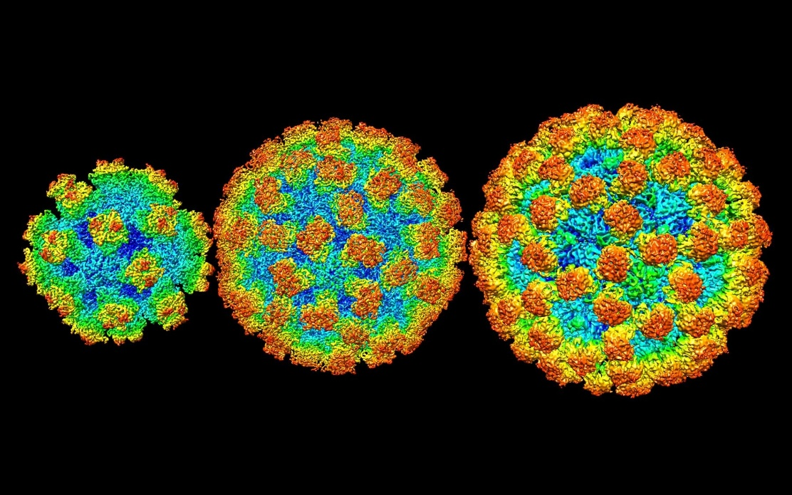
Etiology
‘Norovirus is a small non-enveloped round-structured virus (27-32mm diameter) and can account for greater than 90% of non-bacterial causes of gastroenteritis within health and social care settings
There are at least four norovirus genogroups ( GI,GII, GIII and GIV) which are divided into at least 20 genetic clusters’, Damani, N, (2003)
Very contagious virus that causes vomiting and diarrhoea
Often referred to as stomach flu or stomach bug
Norovirus belongs to the family of caliciviridae, derived from the Latin word ‘calyx’, meaning goblet or cup in reference to the 32 cup-shaped depressions on the surface of the capsid, (Dolin and Treanor, 2009; Collier et al cited Western, D, 2013)

Slide 6
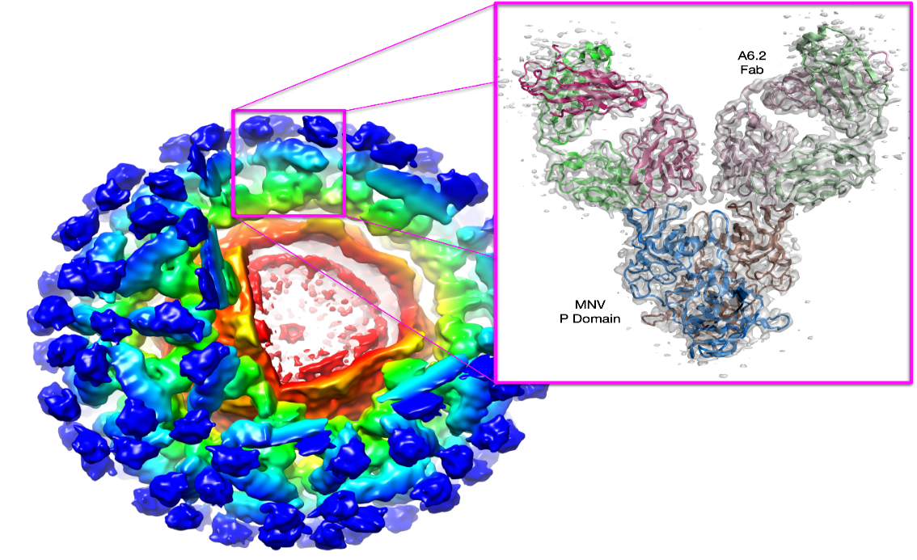
Pathogenesis
Norovirus enters the body through fomites being transferred from the hands to the mouth
The virus is also known to be aerosolised from flushing the toilet and landing on to surfaces or from vomit, (Damani, N, 2012)
HBGA is found on the surfaces of the red blood cells and is also expressed in saliva, in the gut, and in the respiratory epithelia, (CDC, 2015)
10 in 100 particles are needed for norovirus to cause an infection. It is estimated that the norovirus have 500 billions infectious doses contained in each gram of faeces and 30mls of vomit contain up to 30,000,000 particles

Slide 7
Immune Response
Recognition
Innate Phase: Innate immune cells recognize the presence of norovirus through pattern recognition receptors
Adaptive Phase: Dendritic cells capture viral antigens and present them to T cells, initiating the adaptive immune response
Activation of Adaptive Immune System
T Cell Activation: Antigen-presenting cells (APCs) activate helper T cells, which stimulate B cells and cytotoxic T cells
B Cell Activation: B cells are activated, and with the help of helper T cells, they differentiate into plasma cells that produce antibodies specific to norovirus
Antibody Production
Antibody Release: Antibodies circulate in the bloodstream and target norovirus by binding to its antigens
Neutralization: Antibodies neutralize the virus, preventing it from infecting new cells

Slide 8
Immune Response cont…
Cellular Response
Cytotoxic T Cells: Activated cytotoxic T cells identify and destroy norovirus-infected cells
Memory Cell Formation: Some T and B cells become memory cells, providing long-term immunity
Resolution and Memory
Elimination: The coordinated action of antibodies, cytotoxic T cells, and other immune components clears the norovirus infection
Memory Formation: Memory B and T cells remain in the body, ready to mount a rapid and effective response upon re-exposure to norovirus, (Roth, A and Karst, S, 2015)

Slide 9
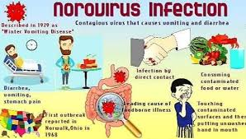
Transmission and communicability
Humans are the only known reservoir, (Hawker, J et al, 2006)
Direct contact with an infected person, (CDC, 2015)
In direct contact such as: food preparation and high touch point surfaces
Vomit can spray throughout the environment
Contaminated water in the drinking/food preparation
Faecal oral route, (Gillespie and Bamford, 2012)
Aerosol routes, coughing and sneezing
When caring for someone who is infected
It has a short incubation period 24-48 hours, individuals are infectious during the acute illness and up to 48 hours post symptomatic, Heyman, D, (2008)
Norovirus can spread quickly in enclosed places, care homes, day centres, hospitals, schools etc
It can remain on objects and surfaces still infecting people for days or weeks, (CDC, 2015)

Slide 10
Diagnosis
Norovirus can be diagnosed based on symptoms
Stool samples
Vomit samples
Food, water and environmental specimens
RT-qPCR assays are the preferred method to detect norovirus because they are very sensitive and specific, Heyman, D, (2008)

Slide 11
Treatment and management
Rest
Encourage residents to remain hydrated, offer little and often sips of fluid to maintain hydration
Symptoms normally subside within 2-3 days, if symptoms persist contact your healthcare provider for support
Contact the GP regarding Residents medication as they may recommend holding certain medications
There is no prescribed treatment, symptom management is key, the risks are when individuals become significantly dehydrated requiring acute admission. (NHS, 2021)

Slide 12
Infection Prevention Management
Do not share foods when there is an outbreak
Use soap and water not alcohol gel, CDC, (2023)
Wash hands using the 5 moments, (WHO 2009)
PPE - use gloves and aprons when supporting individuals suspected of having the virus
Risk assessment and patient placement. Cohort where possible
Wipe down surfaces with a detergent and hypochlorite
When cleaning use disposable cloths/mops wherever possible
Enhanced cleaning
Waste should be discarded as clinical waste
Linen should be treated as infectious, Perry, C,(2007).
Use separate bathrooms and wipe down surfaces immediately after use
Cough Etiquette
Ventilation
Staff should stay at home for 48 hours after last episode of either vomiting or diarrhea
NHS England, ND

Slide 13
References
Centres for disease Control, (2023). About Norovirus | CDC 20/11/2023
Damani, N, (2003). Manual of Infection Prevention and Control, 3rd Edition. New York, Oxford University Press Inc
Gillespie, S. and Bamford, K, (2012). Medical microbiology and Infection at a glance. 4th Edition. John Wiley & Sons ltd
Heyman, D, (2008). Control of communicable diseases manual, 19th Edition 2008. Washington DC, American health association
Hawker, J, Begg, N, Blair, I, Reintjes, R and Weinberg, J, 2006. Communicable disease control handbook, 2nd Edition. Massachusetts, Blackwell Publishing Ltd
Roth, A and Karst, S, (2016). Norovirus Mechanisms of Immune Antagonism. National Library of Medicine, 16;24-30 https://doi.org/10.1016%2Fj.coviro.2015.11.005 24/11/2023
NHS England (2022). National Infection pretention and Control Manual, (NIPCM). NHS England » National infection prevention and control manual (NIPCM) for England. 20/11/2023
NHS, (2021). Norovirus (vomiting bug) - NHS (www.nhs.uk), 20/11/2023.
Norovirus Illness: Key Facts, (2015). Norovirus Illness: Key Facts (cdc.gov) 19/11/2023.
Perry, C, (2007). Infection Prevention and Control, essential skills for Nurses. Oxford, Blackwell Publishing ltd.
Virology research services, (2022). The virus of the month: norovirus | VIROLOGY RESEARCH SERVICES 20/11/2023.
WHO, (2009). Your 5 moments for Hand Hygiene. World Health Organisation, (2009). New_5_Moments_Poster (who.int) 20/11/2023
WHO, (2023). Immunization, Vaccines and Biologicals. Immunization, Vaccines and Biologicals (who.int). 20/11/2023
Weston, D, (2013). Infection Prevention and Control, Therapy in practice. 2nd Edition. West Sussex, John Wiley and son’s Ltd.

