Slide 1
Respiratory Update
Somerset Quality Improvement project - aligning patients prescribed MDI + DPI inhalers to a single device pathway
‘Patients on aligned inhalers will have lower prescribing costs and less admissions, bed days and mortality’

Slide 2
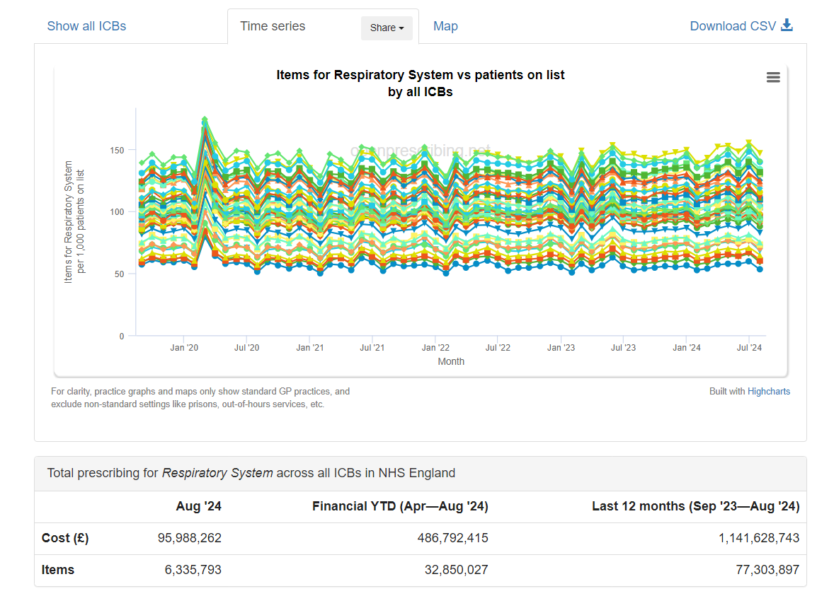
£1.14 billion national respiratory prescribing spend

Slide 3
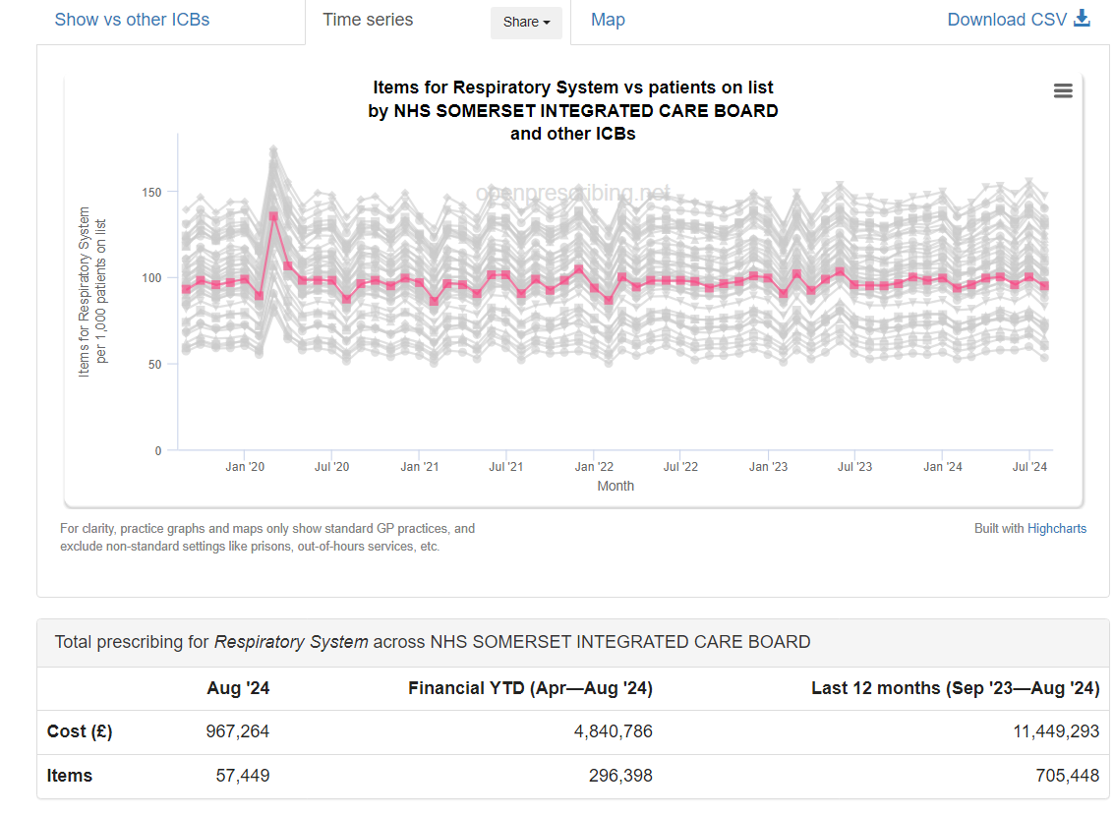
£11.4 million Somerset spend respiratory prescribing spend (1% of spend pro rata with pop)

Slide 4
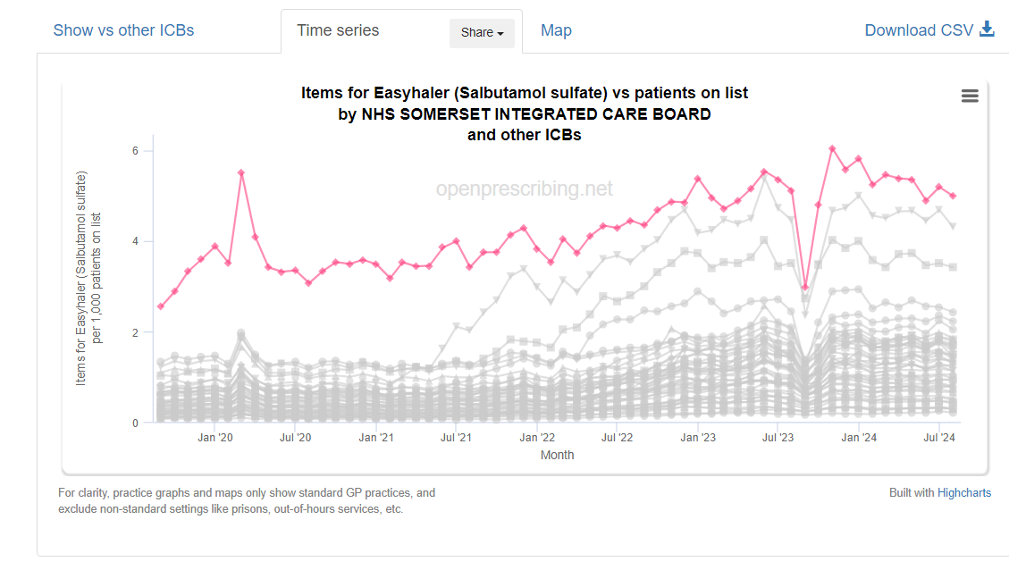
Highest use of salbutamol Easyhaler DPIs in England (twice the cost of MDI but worth it!)

Slide 5
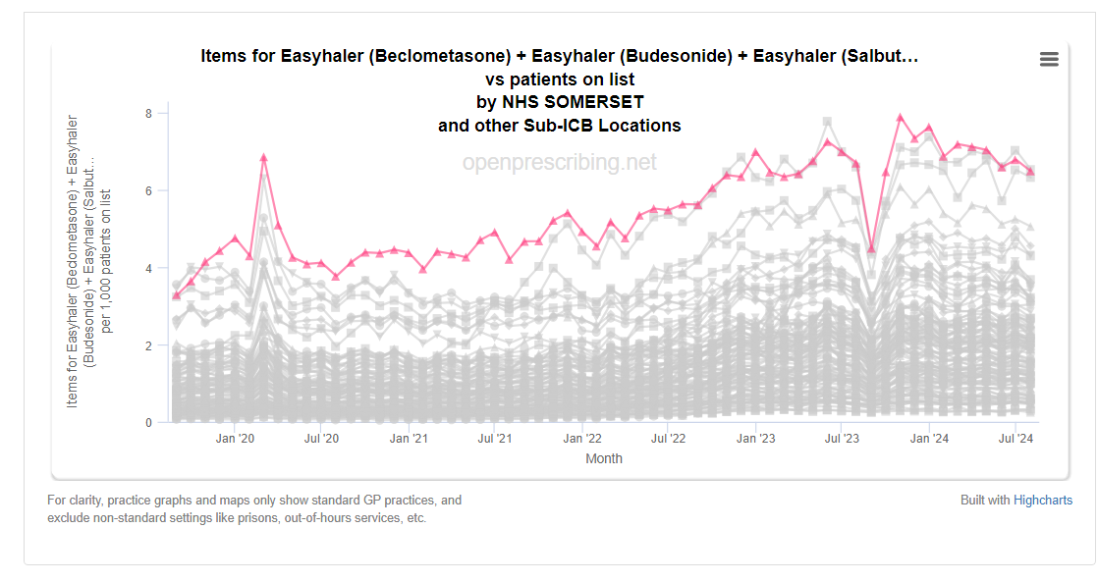
Highest use of all Easyhaler DPIs in England –single pathway approach

Slide 6
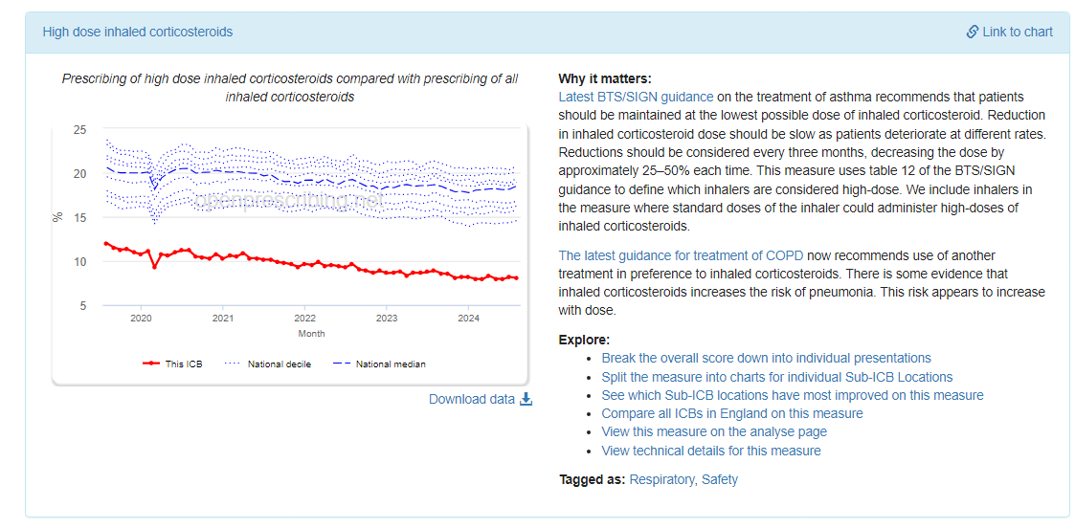
Best in England – reducing high dose steroids (above 20% when we started)

Slide 7
% of asthma patients with 3 or more inhaled steroids

Slide 8
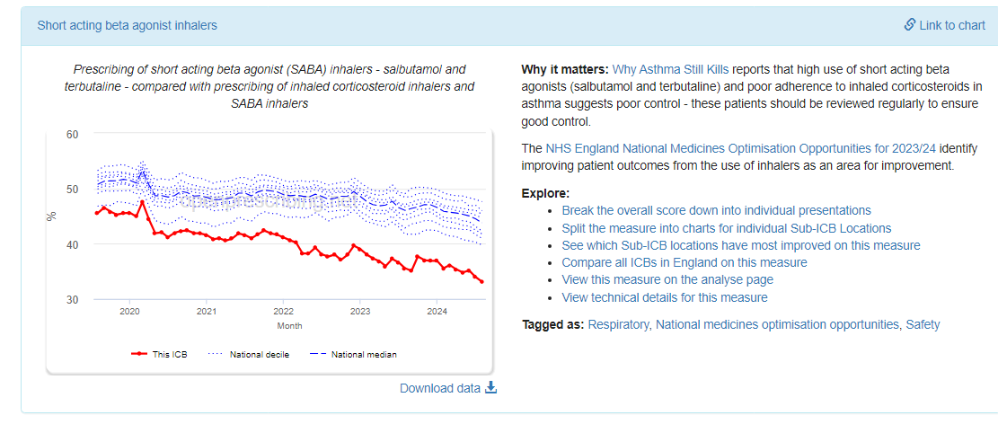
Best in England – reducing over-use of SABAs (better control less need for SABAs)

Slide 9
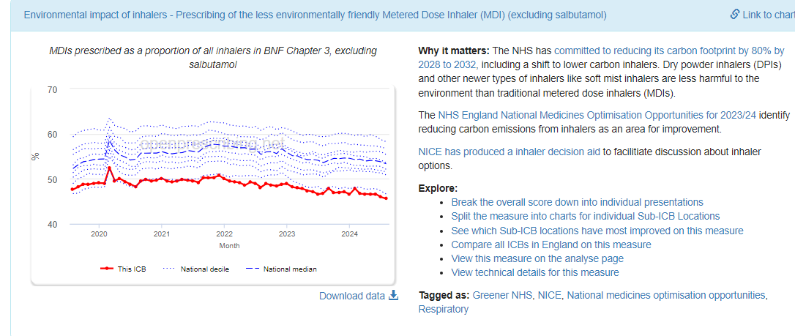
5th percentile for use of MDIs (not including SABA) (align to MDI pathway if pt has best MDI technique)

Slide 10
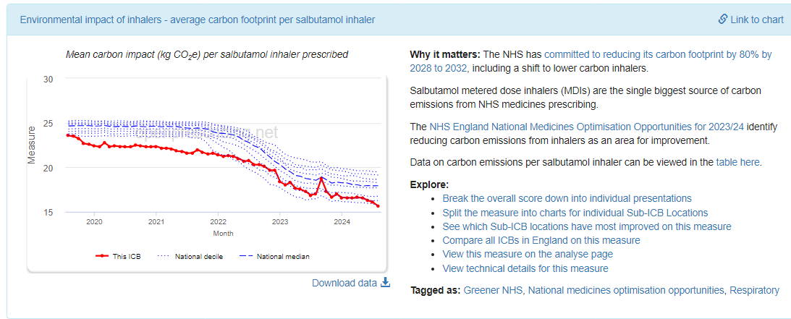
10th percentile salbutamol environmental impact (some still prescribe generically rather than as Salamol)

Slide 11
OUTCOMES – Eclipse national data shows patients on aligned inhalers have less admissions, bed days and mortality
Remember Somerset has 20% higher COPD prevalence and
12.5% higher prevalence of Asthma
High dose steroids associated with pneumonia admissions
ESR - Randomised trials and observational studies clearly demonstrate that ICS increase the incidence of pneumonia and pneumonia-related mortality

Slide 12
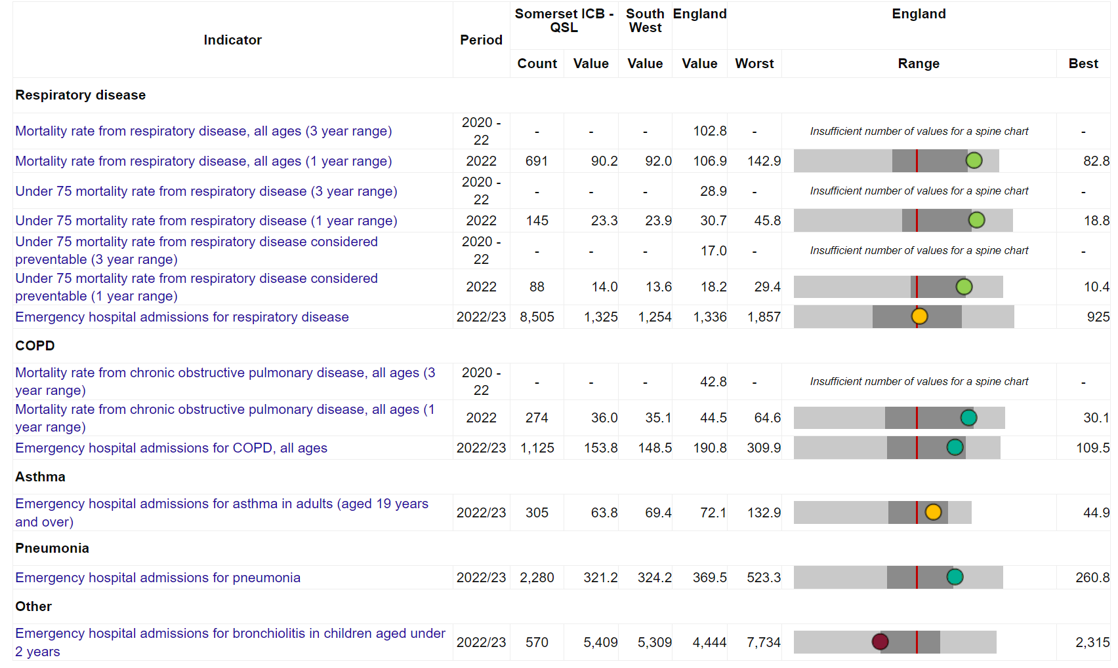

Slide 13
Asthma admission rates SW

Slide 14
Thank You
SHAUN GREEN – Chief Pharmacist
Somerset ICB

